Slide 1

Portfolio Tracker Database
It tracks, analyzes, and summarizes investment portfolios across users, assets, and time.
By Nicolas Fabian Adell
- From Buenos Aires, Argentina
- Gmail: nicolas.fabian2005@gmail.com
- GitHub: github.com/nicolasadell
- edx username: nico_ad05
- Date: July 15th, 2025

Slide 2
📊 Scope
Track asset purchases, sales, and dividends
View current and historical market prices
Calculate realized and unrealized profits
Summarize portfolios and asset allocation
Useful for individual investors, brokers, and fintech platforms

Slide 3
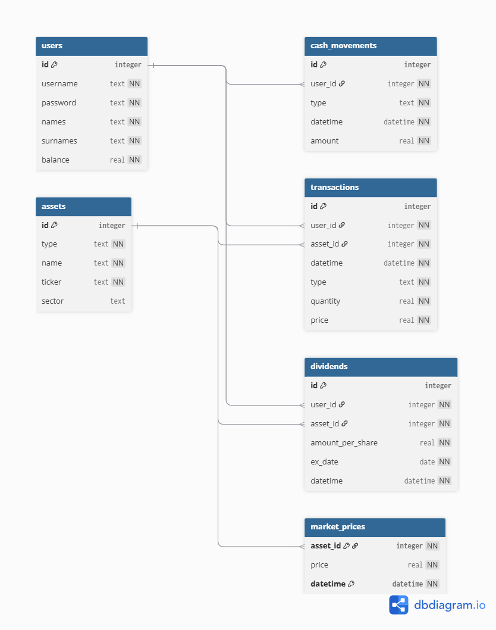

Slide 4
✅ Thanks for Watching!
Questions or feedback?
Nicolas Fabian Adell
From Buenos Aires, Argentina
Gmail: nicolas.fabian2005@gmail.com
LinkedIn: nicolas fabian adell
https://www.linkedin.com/in/nicolas-fabian-adell/
GitHub: github.com/nicolasadell
edx username: nico_ad05

